Slide 1

Selenium
Selenium
A Test Automation Tool

Slide 2
Topics ?
Following are the topics covered in this module :
Introduction to Selenium
Selenium WebDriver
Waits in Selenium
X-path in Selenium
TestNG in Selenium
Jenkins and Selenium Integration

Slide 3
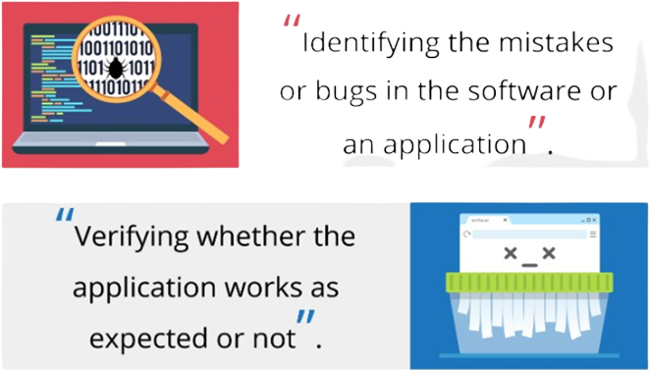
What is Testing ?
.

Slide 4
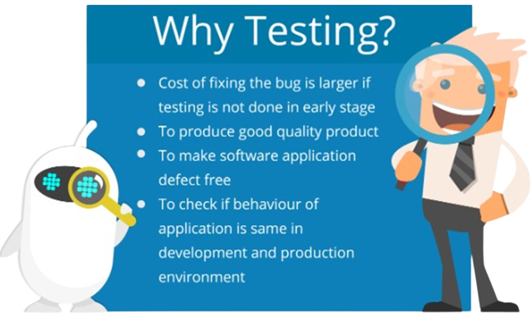
Why testing ?
.

Slide 5
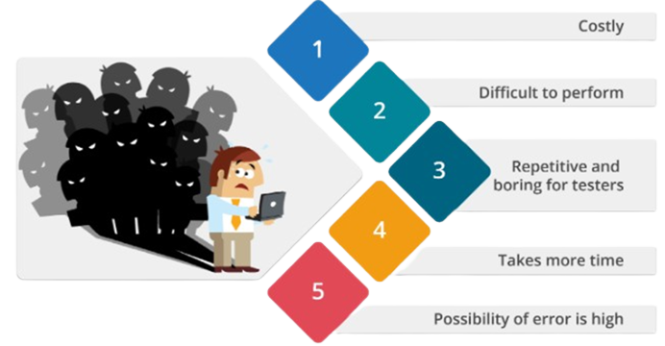
Problems with Manual Testing ?
.

Slide 6
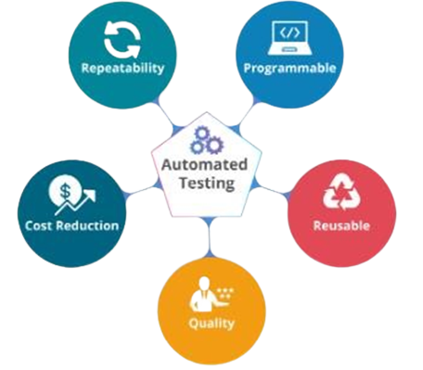
Automated Testing
“ It is performed by using automation tools to run test cases and like Regression testing it is also used to check an application from Load, Performance and Stress point of view”.

Slide 7
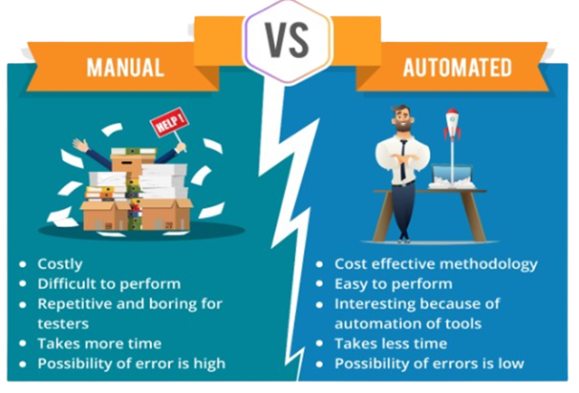
Manual Testing Vs Automated Testing
.

Slide 8
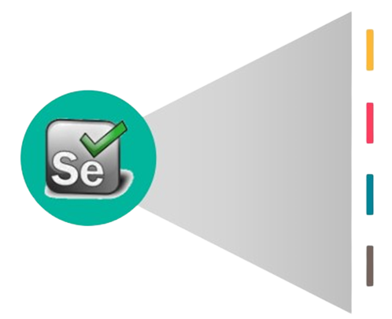
What is Selenium ?
Selenium is a tool which is used to automate web applications across different platforms using different programming languages
It is Open source and mainly used for functional and regression testing.
Known for better performance and execution speed
Best tool for testing web application.

Slide 9
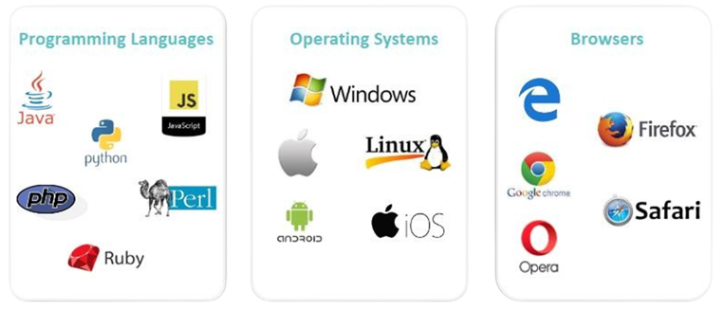
Selenium Supports the Following
.

Slide 10
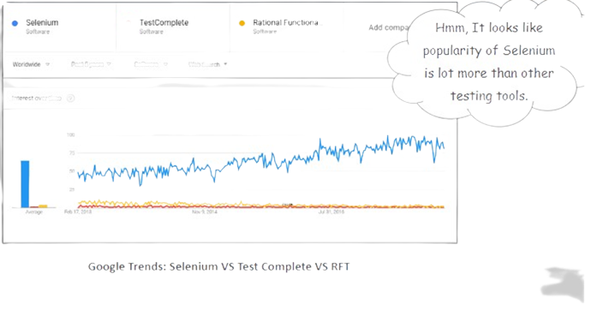
Selenium Popularity: Google Trends Results
.

Slide 11
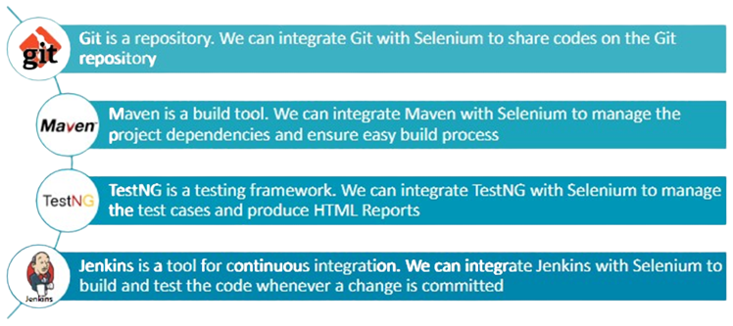
Tool that can be Integrate with selenium
.

Slide 12
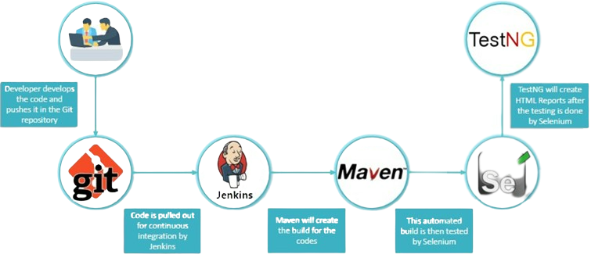
Integration of selenium with Other Tools
.

Slide 13
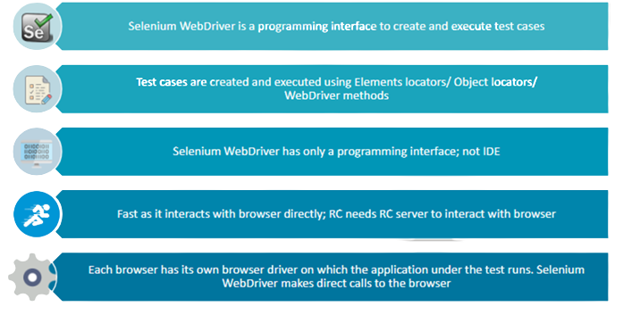
What is Selenium WebDriver ?
.

Slide 14
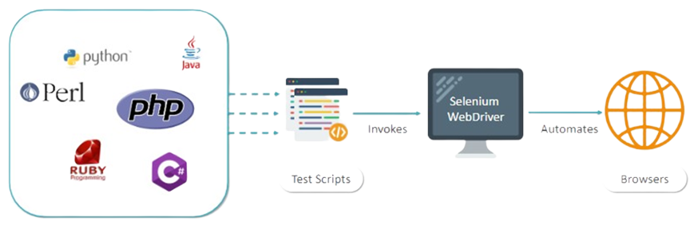
Working of Selenium WebDriver
.

Slide 15
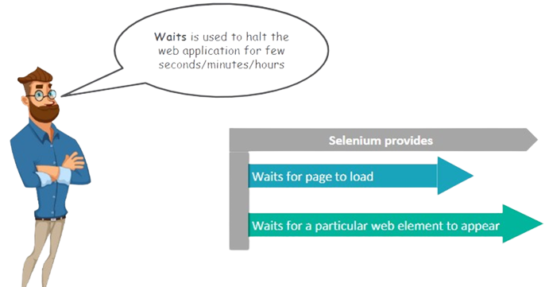
Use of Waits
.

Slide 16
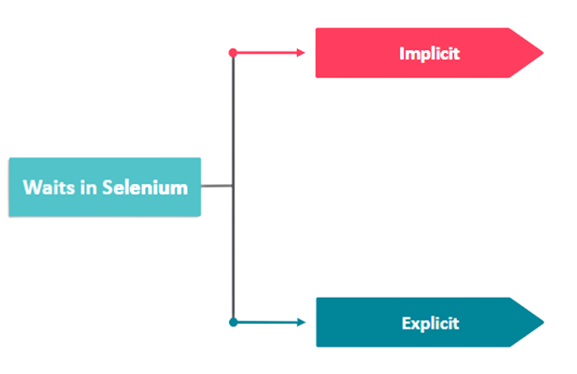
Important Types of Waits
.

Slide 17
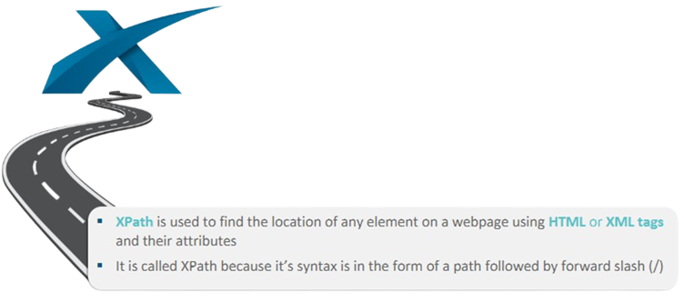
What is X-Path ?
.

Slide 18
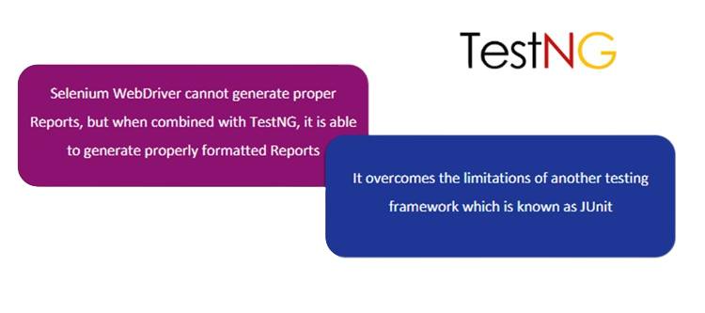
Why TestNG ?
.

Slide 19
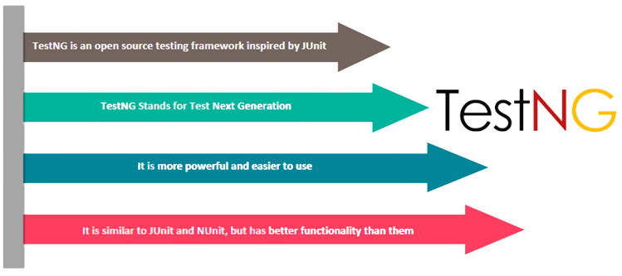
What Is TestNG ?
.

Slide 20
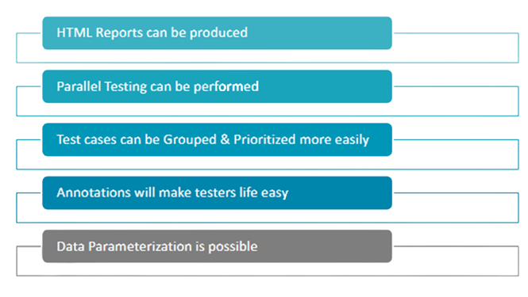
Advantages of TestNG
.

Slide 21
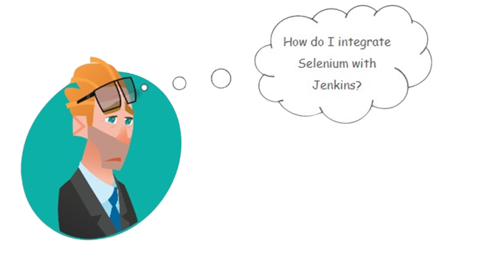
Problem: Integrating Selenium with Jenkins
.

Slide 22
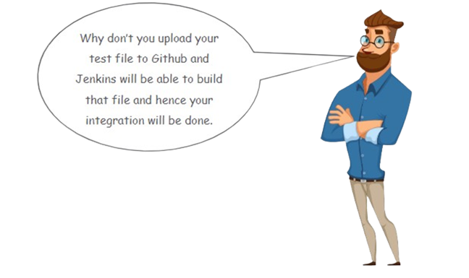
Solution
.

